Slide 1


MA-505 Bristol County Continuum of Care
BC³
The FY2024 CoC Competition
and Funding Round
Continuum of Care
Taunton/Attleboro/Bristol County/New Bedford
Collaborative Applicant
Office of Housing & Community Development

Slide 2

OVERVIEW
1. CoC Competition Basics
2. HUD’s Policy and Program Priorities
3. Available Funding
4. The Process
5. Ranking Recommendation

Slide 3
1. CoC Competition Basics
THE APPLICATION TO HUD HAS THREE PARTS:
  Collaborative Application
  Individual Project Applications
  A Project Priority Listing

Slide 4
1. CoC Competition Basics
  Collaborative Application
Rigorously scored
Questions the CoC’s governance, strategic planning and system performance
Evaluates CoCs based on how well they:
  Advance HUD’s priorities
  Strategically move toward eliminating homelessness
  Demonstrate success

Slide 5
1. CoC Competition Basics
  Individual Project Applications
Every CoC conducts a competitive process to encourage new and renewal project submissions
Initial local application process with scoring and ranking
CoCs decide what they need locally to advance HUD’s priorities and what projects they want to do that work.
The CoC’s Performance Review Committee (PRC) objectively reviews /scores/recommends ranking to the full CoC
Selected projects added to CoC’s submission to HUD.

Slide 6
1. CoC Competition Basics
  Project Priority Listing
Every CoC must assemble and provide details about its funding requests by project.
Listing includes reallocation amounts
Listing includes projects by category (PSH, RRH, etc.)
HUD holds CoC accountable for its project selections and funding requested

Slide 7
1. CoC Competition Basics
The FY2024 Continuum of Care Program Competition NOFO
(Notice of Funding Opportunity)
The NOFO was Released on July 31, 2024
Bristol County CoC issued an RFP for Projects August 10, 2024
Bristol County CoC Project Deadline August 30, 2024
BCCC vote on Ranking September 19, 2024
Bristol County CoC Internal Deadline for Submission October 24, 2024
Deadline is October 30, 2024

Slide 8
2. HUD’s Policy and Program Priorities
Ending homelessness for all persons.
Using a Housing First approach.
Reducing unsheltered homelessness.
Improving system performance.
Partnering with housing, health and service agencies.

Slide 9
2. HUD’s Policy and Program Priorities
Racial equity.
Improving assistance to LGBTQ+ individuals.
Authentically involving persons with lived experience/expertise.
Building an effective workforce.
Increasing affordable housing supply.

Slide 10
3. Available Funding
Opportunities in 2024:
Renewal Projects
  All current CoC projects
  PSH, Coordinated Entry and HMIS Renewals
New Projects
Funded with CoC Bonus Funding and/or Reallocation dollars
PH-PSH (Permanent Supportive Housing) for Individuals
PH-RRH (Rapid ReHousing) Projects
Joing TH/PH-RRH for Individuals or Families
Expansion Projects
DV Bonus Projects
Funded with DV Bonus Funding and/or Reallocation dollars
PH-RRH (Rapid ReHousing) Projects
SSO Project for Coordinated Entry (SSO-CE)
Grant Consolidation Projects
CoC Planning
The planning grant is being proposed to again fund a data specialist (Simtech) and hire a new consultant/staff exclusively for CoC work

Slide 11

So how much funding is available for the
Bristol County CoC in the FY2024 CoC grant round?

Slide 12
3. Available Funding
PPRN | ARD
Est.Pro Rata Need. This is the amount HUD calculates as being available to the CoC. | Annual Renewal Demand. This is the amount it would cost to only renew what we have already.
$4,685,992 | $3,125,857

Slide 13
3. Available Funding
CoC BONUS
CoC Bonus. HUD sets the bonus amount every year based on what it receives through Congress.
$562,319
DV BONUS
Domestic Violence Bonus. HUD has again offered a special bonus for DV related projects.
$702,889

Slide 14
3. Available Funding
PPRN | ARD | TIER SYSTEM |  | CoC BONUS
Est. Pro Rata Need. This is the amount HUD calculates as being available to the CoC. | Annual Renewal Demand. This is the amount it would cost to only renew what we have already. | Tier 1 90% of the ARD*. This year, because Tier 1 is set at 90%, not all renewal projects can fit into this first tier, thus ensuring some will be at risk of cuts. | Tier 2 The difference between Tier 1 and the maximum amount of renewal, reallocation and CoC Bonus funds the CoC can apply for excluding planning grant. | CoC Bonus. HUD sets the bonus amount every year based on what it receives through Congress.
$4,685,992 | $3,125,857 | $2,813,271 | $1,577,794 | $562,319
DV BONUS
Domestic Violence Bonus. HUD has again offered a special bonus for DV related projects.
$702,889
* This year, HUD is allowing just 90% of all first-time renewals to be included in Tier 1, a reduction from 2023’s 93% level.

Slide 15
3. Available Funding
PPRN | ARD | TIER SYSTEM |  | CoC BONUS
Est. Pro Rata Need. This is the amount HUD calculates as being available to the CoC. | Annual Renewal Demand. This is the amount it would cost to only renew what we have already. | Tier 1 93% of the ARD. This year, because Tier 1 is set at 93%, not all renewal projects can fit into this first tier, thus ensuring some will be at risk of cuts. | Tier 2 The difference between Tier 1 and the maximum amount of renewal, reallocation and CoC Bonus funds the CoC can apply for excluding planning grant. | CoC Bonus. HUD sets the bonus amount every year based on what it receives through Congress.
$4,685,992 | $3,125,857 | $2,813,271 | $1,577,794 | $562,319
* This year, HUD is allowing just 90% of all first-time renewals to be included in Tier 1, a reduction from 2023’s 93% level.

Slide 16
3. Available Funding
PPRN | ARD | TIER SYSTEM |  | CoC BONUS | PLANNING
Est. Pro Rata Need. This is the amount HUD calculates as being available to the CoC. | Annual Renewal Demand. This is the amount it would cost to only renew what we have already. | Tier 1 93% of the ARD. This year, because Tier 1 is set at 93%, not all renewal projects can fit into this first tier, thus ensuring some will be at risk of cuts | Tier 2 The difference between Tier 1 and the maximum amount of renewal, reallocation and CoC Bonus funds the CoC can apply for excluding planning grant. | CoC Bonus. HUD sets the bonus amount every year based on what it receives through Congress. | Added Funds This funding is only permitted for planning purposes. It does not get ranked within the tiers.
$4,685,992 | $3,125,857 | $2,813,271 | $1,577,794 | $562,319 | $234,300

Slide 17
3. Available Funding
PPRN | ARD | TIER SYSTEM |  | CoC BONUS | PLANNING
Est.Pro Rata Need. This is the amount HUD calculates as being available to the CoC. | Annual Renewal Demand. This is the amount it would cost to only renew what we have already. | Tier 1 93% of the ARD. This year, because Tier 1 is set at 93%, not all renewal projects can fit into this first tier, thus ensuring some will be at risk of cuts. | Tier 2 The difference between Tier 1 and the maximum amount of renewal, reallocation and CoC Bonus funds the CoC can apply for excluding planning grant. | CoC Bonus. HUD sets the bonus amount every year based on what it receives through Congress. | Added Funds This funding is only permitted for planning purposes. It does not get ranked within the tiers.
$4,685,992 | $3,125,857 | $2,813,271 | $1,577,794 | $562,319 | $234,300

Slide 18
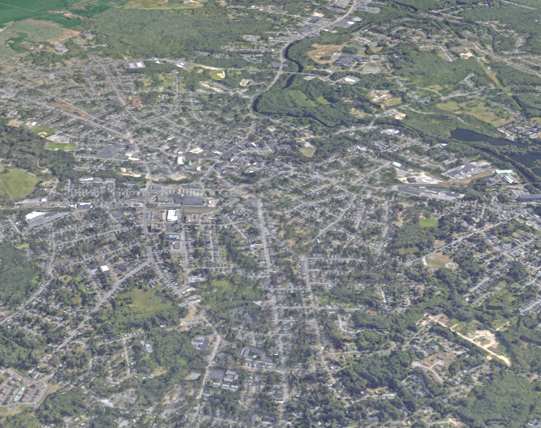
How will this work in the
Bristol County CoC?

Slide 19
4. The Process
The City of New Bedford’s Office of Housing & Community Development is the “Collaborative Applicant” representing the Continuum.
Because of that, it is responsible for submitting the complete CoC application on behalf of the whole Continuum…

Slide 20
4. The Process
…however
Unlike many other grants, the CoC’s Collaborative Application is a reflection of performance and strategy over the course of a year
and is not simply a proposal to do something.
Largely it’s a reflection of
DATA | PERFORMANCE | PROCESS.
The Collaborative Application is all about our community’s response to housing crises and our entire system—proactive and reactive—in moving the needle forward to end homelessness for everyone.
It is a reflection of every part of the CoC.

Slide 21
4. The Process
Undertaking the review…
City’s OHCD Staff reviews all applications submitted
Reviews of all new, renewal and reallocation applications using standardized scoring sheets and ensures completeness of threshold criteria.
The BCCC’s Performance Review Committee is convened
Members attending this round: Zach Boyer, Matt Dansereau, Dan Joyce, Josh Amaral and Joe Maia.
General responsibilities of the PRC:
1. Review all applications for funding
Review any new project submittals, proposed reallocations and existing CoC Programs that are
slated for renewal.
2. Evaluate and assess the proposals in light of the Continuum’s existing needs and gaps, as well
as the funding HUD will make available.
3. Make a recommendation for a slate of projects to be funded in order of priority and by tier in
accordance with HUD funding criteria.

Slide 22
4. The Process
Reviewing the project applications…
Projects were evaluated on the following criteria:
Health Partnerships
Racial Equity/Inclusivity Measures
Authentic incorporation of those with lived experience
Extent to which it prioritizes serving chronically homeless
Extent to which it employs a housing first model
Applicant’s performance against plans and goals
Timeliness standards
Applicant’s performance in assisting program participants achieve and maintain independent living and its record of success
Financial management accounting practices
Timely expenditures
Agency capacity
Eligible activities

Slide 23
4. The Process
Reviewing the project applications…
Projects were evaluated on the following criteria:
Health Partnerships
Racial Equity/Inclusivity Measures
Authentic incorporation of those with lived experience
Extent to which it prioritizes serving chronically homeless
Extent to which it employs a housing first model
Applicant’s performance against plans and goals
Timeliness standards
Applicant’s performance in assisting program participants achieve and maintain independent living and its record of success
Financial management accounting practices
Timely expenditures
Agency capacity
Eligible activities
IMPORTANT!
The extent to which the project fills a gap within the CoC, improves the CoC’s ability to end homelessness and does/can improve the overall performance of the CoC.

Slide 24

So what is the PRC’s ranking recommendation for FY2024?

Slide 25
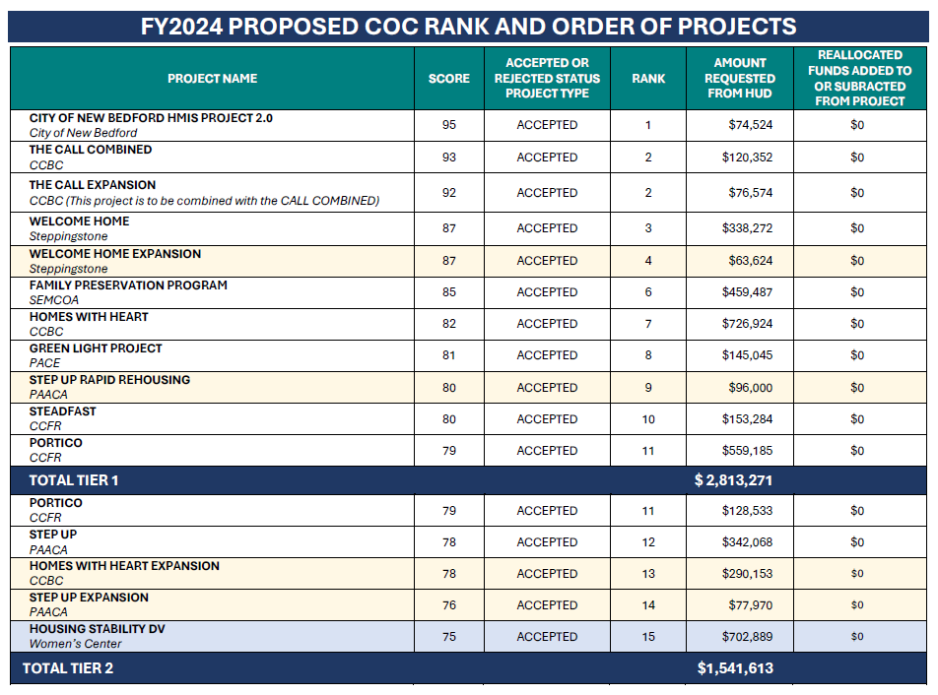

Slide 26
MA-505 Bristol County Continuum of Care
BC³
The FY2024 CoC Competition
and Funding Round
Continuum of Care
Taunton/Attleboro/Bristol County/New Bedford
Collaborative Applicant
Office of Housing & Community Development

